Slide 1

Customized Rate Funding
Everything You Need to Know
Carrie Ottoson, Community Programs Manager
Gina Koke, Customized Rate Technical Consultant
Virginia Department of Behavioral
Health and Developmental Services
Notes:
Hello, thank you for joining me for “Customized rate funding, everything you need to know”. My name is Gina Koke and I am a Customized Rate Technical Consultant at DBHDS.

Slide 2

What is Customized Rate Funding?
Effective June 1, 2017, by approval from CMS
Additional Funding Within The Waiver System
Waiver services that allow for a rate that is unique to the individual based on exceptional support needs
Notes:
First who's learn about how the CR began. It started in 2017 with approval from CMS – which is the federal agency responsible for administering Medicare & Medicaid Services. Sometimes there are individuals whose behavioral and/or medical needs are exceptional and require more support than the average person receiving services. We call these individuals “outliers”. The current reimbursement structure sets specific amounts that providers of waiver services can expect to receive for each services. We collectively call this the standard rate. There are times when the standard rate is not enough to be able to provide supports to those with exceptional needs. The CR was therefore created to provide additional funding to providers who support these individuals in the community.

Slide 3
Decision Stats as of March 2025
Over 2,100 total applications to date
75.6% Approved
7.4% Denied
7.4% Withdrawn
Notes:
As of March 2025 the customized rate for the commonwealth of Virginia has processed over 2,000 applications. Over 75.6 percent of those applications have been approved, 7.4 have been denied and 7.4 percent were withdrawn.

Slide 4
Who Qualifies?
Exceptional
medical and/or behavioral
needs
Supports
outweigh resources
in the current Waiver structure
Documented need
for 1:1
or
2:1 staffing
Notes:
So lets talk about who qualifies. As mentioned, individuals with exceptional behavioral and /or medical needs, that require more intensive supports and have a documented need for 1:1 or 2:1 staffing .

Slide 5

Funding Source of Last Resort
The Customized Rate should be sought when all other avenues for assistance have been exhausted
Other Waiver services
Crisis funding
Natural supports
Other community resources
Notes:
Not everyone who has exceptional medical or behavioral needs will require funding from the customized rate. First, support teams should investigate whether there are other waiver services like nursing, therapeutic consultation or day services that could provide some of the support needed. Crisis funding may also be available short term, as well as natural supports such as family, friends, churches, clubs or other community services.

Slide 6
Eligible Waivers
Family & Individual Supports Waiver | Community Living Waiver
Community Coaching | Community Coaching
Group Day | Group Day
In-Home Supports | In-Home Supports
Supported Living | Supported Living
 | Sponsored Residential
 | Group Home
.
Notes:
There are 3 developmental disability waivers in Virginia, only 2 have services that qualify. Here you see the list of services within the CL and FIS waivers that are eligible.

Slide 7
Customized Rate Roles
Administrator | Processor | Customized Rate Technical Consultant (CRTC) | Customized Rate Review Committee (CRRC)
Notes:
You can see here that there are 4 different roles within the customized rate department. Lets take a look at each of them.

Slide 8
Customized Rate Administrator
The Administrator is the program manager and is responsible for overseeing the customized rate process.
Call the administrator when you have macro level questions or concerns or to discuss the customized rate process as a whole.

Slide 9
Customized Rate Processor
The Processor manages incoming applications to ensure that they are complete. This includes ensuring that all documentation has been uploaded to the WaMS application.
Call the Processor when you need information relating to where your application is in the process or with general submission questions.

Slide 10
“Complete” Application?
“Complete”
The processor has reviewed the contents and determines that it meets all criteria for submission.
(Clicking the “submit” button does not capture the date.)

Slide 11

Customized Rate Technical Consultant
(CRTC)
The CRTC acts as the primary liaison between the provider and committee by working with providers to prepare them for committee review. This included but is not limited to:
Training and support
Direct on-site support
Preliminary assessments of applications

Slide 12
CRTC Assessment
Refer the Application To Committee
DENY
Notes:
Once the assessment is completed the CRC can decide to move to committee review OR deny

Slide 13
Customized Rate Review Committee
(CRRC)
Team Of Experts
Medical
Behavioral
Integrated Supports
Service Authorization
Regional Supports
Reviews all applications and determines if a Customized Rate is warranted

Slide 14
Committee Meeting
Providers are notified of the date the committee meeting is scheduled
Meetings typically occur each Wednesday and alternate Thursdays between 9am and 12pm, within 30days of receipt
Meetings are scheduled in the order in which a completed application is received
Notes:
So lets talk about the committee meetings. Meetings are typically held each Wednesday and alternate Thursdays from 9am – 12pm. Providers are notified of the meeting date by the CRTC and should try to be available during that timeframe. The reason for that is that sometimes committee members have a question that cannot be answered by the information provided. So during the meeting we will reach out to the provider in an attempt to get the question answered. Please don’t allow this to frighten you. If you happen to be unavailable, the committee will simply pend the application until the following meeting. During that time the CRTC will reach out to the provider in an attempt to get the answer needed. One thing to be aware of is that the applications are presented in the order in which they are completed. It is imperative that the provider work with the processor and CRTC to submit all requested items so that the application can move along more swiftly. A lot of the processing time is dependent upon how quickly the provider is able to respond to requests for information.

Slide 15
AVAILABLE SUPPORTS
.

Slide 16
3 Types of Support
Increased Staffing
Specialized Staffing
Program Oversight
1 Staff : 1 Individual
2 Staff : 1 Individual
Combination of Both
Provided by a DSP who has a higher level of expertise and meets credentialing criteria
Higher qualified supervision of direct supports

Slide 17
Specialized DSP Criteria
LEVEL ONE
A College Degree
LEVEL TWO
Licensure
LEVEL THREE
Specialized Training & 5 Years Experience
U.S. Department of Education College Accreditation database: https://ope.ed.gov/dapip
Degrees obtained outside of the United States

Slide 18
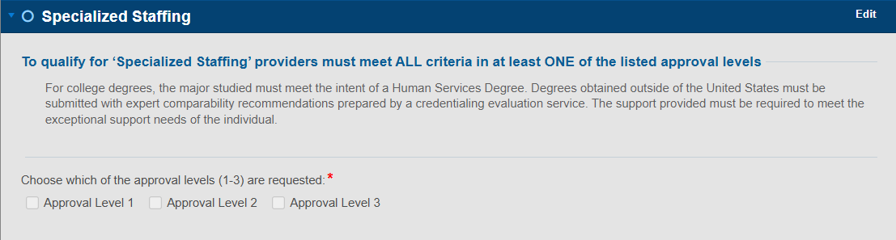
WaMS Screenshot

Slide 19
Program Oversight Criteria
LEVEL ONE
A Masters Degree
LEVEL TWO
A Bachelor’s Degree and Licensing
LEVEL THREE
A Bachelor’s Degree, Specialized Training & 5 yrs. Experience
U.S. Department of Education College Accreditation database: https://ope.ed.gov/dapip
Degrees obtained outside of the United States

Slide 20
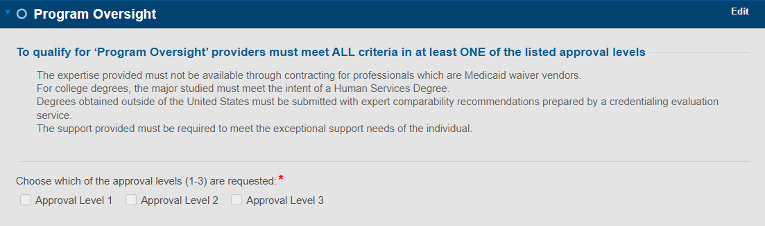
WaMS Screenshot

Slide 21

Staffing Definitions
1 or 2 staff assigned to the individual served, whose
sole responsibility
is to support the needs of the individual during the time that supports are approved.

Slide 22
Staffing Protocol
Providers must upload a protocol outlining the specific duties of the staff providing 1:1 or 2:1, which should be individualized based on the person's needs as outlined in the
Individualized Service Plan (ISP).
Duties such as cooking meals, cleaning, or staff burnout do not constitute the need for 2:1 staffing
*

Slide 23
Staffing Protocol
Defines specifics using common language such as:
Types of support needed
Type of support
Hours of support
Physical distance
Responsibilities
Privacy concerns
Safety Checks
Documentation

Slide 24
WaMS APPLICATION
.

Slide 25
Application
November 9, 2020, Waiver Management System (WaMS)
The individual must have:
A Supports Intensity Scale® (SIS)
An active enrollment in a Waiver program
An assigned Support Coordinator
Without supporting documentation, the application is not complete

Slide 26
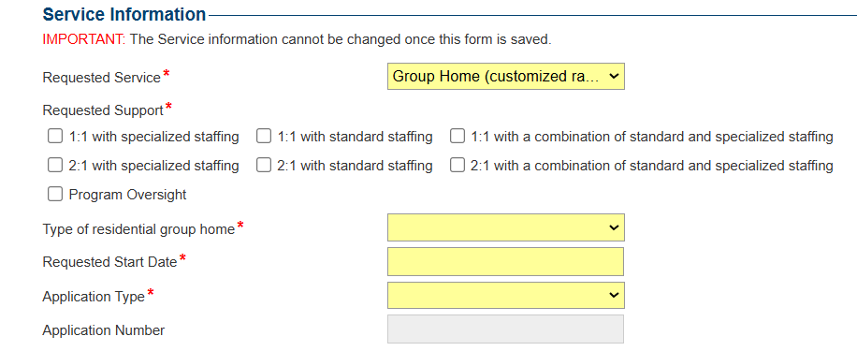

Selecting Supports
Notes:
On the General Information section of the application, you will select the supports that you are requesting. This section CANNOT be changed once you have saved.

Slide 27
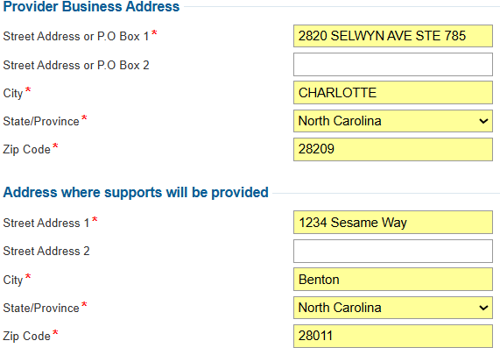
Address of Supports

Slide 28
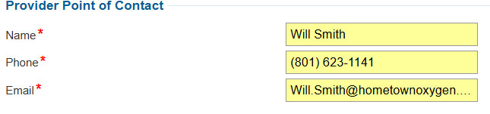
Point of Contact

Slide 29
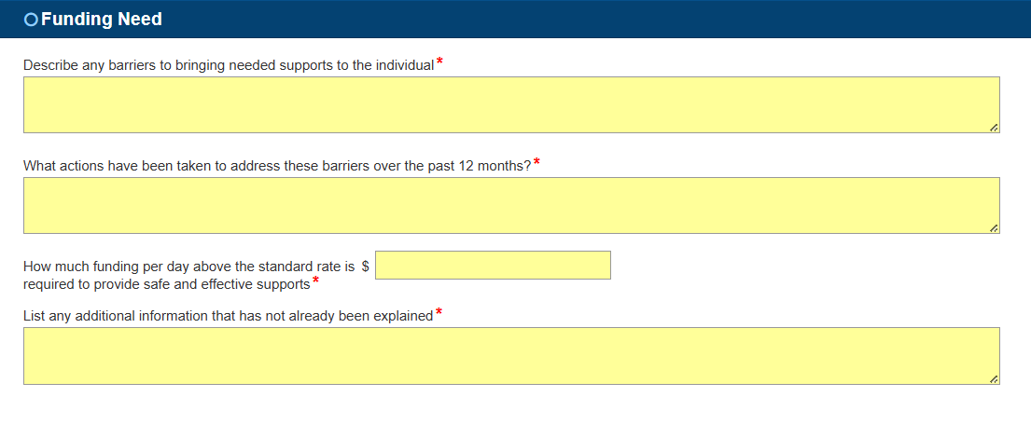
“Any Additional Information…”

Slide 30
SUPPORTING DOCUMENTATION
.

Slide 31
Quick Tips
Day of Admission
Start collecting raw data
Behavioral (do not need a behaviorist to start doing this)
Medical
Logs (seizure, bowel)
Request referrals from the Support Coordinator
Therapeutic Consultation
Nursing Services
Day Services/Work/Volunteer

Slide 32
Provider Responsibility
It is the provider’s responsibility to provide evidence of exceptional need
Provider
Behaviorist/ Medical Staff
Support Coordinator
Notes:
Ultimately, it is the provider’s responsibility to coordinate care between various service providers. This means that the provider should be in regular contact with the Support Coordinator to secure services, save email correspondences to submit with the customized rate application, and be prepared to respond to questions from the committee regarding waitlist status for services. In addition, providers should be prepared to be in regular contact with other service providers such as the behaviorist or medical staff. Often providers are requested to provide data or documentation that must come directly from behaviorist. It is the providers responsibility to ensure that the behaviorist knows what is being requested. Nathan will speak more on this from the behavioral perspective as we get further into discussion.

Slide 33
Documentation
Requested Documentation Where applicable
Behavioral Support Plan | Form SF-20
Behavioral Data | Incident Reports
Health Supports Data | Provider License
Quarterly Reports | Notice of Action Requirements
Staff Credentials | 1:1 or 2:1 staffing protocol
Payroll Verification | Crisis Plan
Overnight Support | Additional information as requested

Slide 34
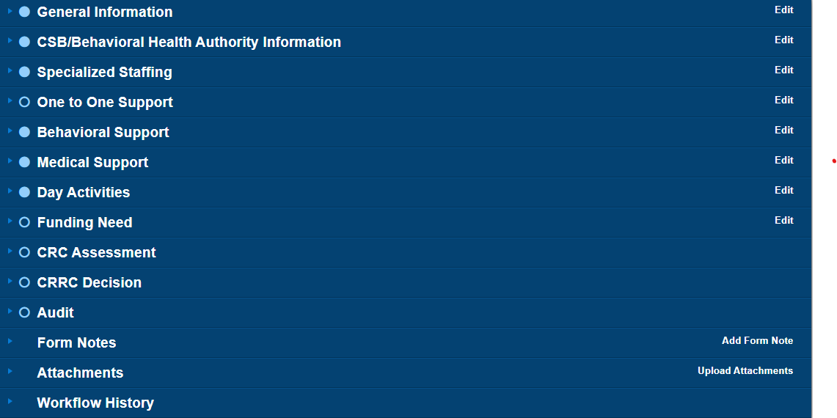
Upload Documents

Slide 35
OVERNIGHT DATA

Slide 36

Overnight Data - Be Specific
What is today’s date?
What time is it?
What is the individual doing?
What did staff do to intervene?
.

Slide 37
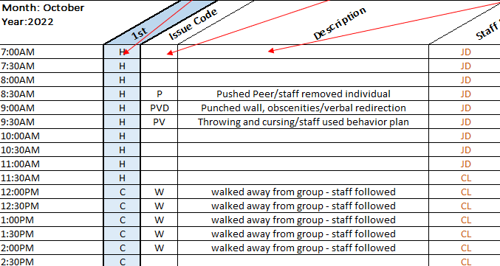

Overnight Support Example

Slide 38
APPROVED APPLICATIONS

Slide 39
Approval Types
Full Term
Contingent
The rate is approved through the end of the individual’s ISP
The rate is approved for a short term

Slide 40
Notifications
When a decision has been made on a customized rate application, a Notice of Action (NOA) letter will be emailed
The NOA will provide detailed information
The provider is called for an exit interview at which time the NOA will be discussed.

Slide 41
Notice of Action Requirements
If the Customized Rate Review Committee makes recommendations or requirements in the Notice of Action, the provider must respond to them.
Failure to respond or provide evidence that these actions steps have been explored and/or adopted at the time of the next review may result in a denial
Notes:
Providers might be asked to collect additional data or to adopt specific documentation requirements often related to how behavioral or medical supports are documented, measured, and analyzed. Providers might also be asked to show evidence of the exploration of other Waiver services.

Slide 42
ANNUAL RENEWALS

Slide 43
Provider Responsibility
Collect detailed documentation/data during the approval period
Reapply at least 30 days prior to the end date
Respond to NOA recommendations
Communicate any changes
Ask for help
Notes:
Providers should start planning for the annual review the day they are initially approved. Documentation must occur throughout the plan year.

Slide 44
Documentation Requirements
All documentation required at the time of an initial application is also required at the time of an annual application
Providers should plan to document throughout the plan year the duration, frequency and intensity of supports provided in a concise manner
If 2:1 supports are approved, providers should be prepared to evidence through documentation that 2 staff provided support and be able to evidence the duration and frequency of the support by each staff
Notes:
At the time of an annual review the committee is looking to determine 1) that the support needs are still present AND 2) that the supports approved at the time of the initial application have been provided.

Slide 45
Annual: Special Requirements
Providers are responsible for responding to requests for additional information throughout the year
Site visits may be conducted at any time during the approval period
Providers may request a site visit
DBHDS reserves the right to review an approved customized rate at any time throughout the year and adjust the rate as deemed necessary

Slide 46

Communication is key!
Providers are responsible for notifying DBHDS of any changes in the individual’s support needs
These include but are not limited to:
support needs
SIS© levels
license
address
approved staff
Providers are responsible for any fiscal impact due to failure to report changes

Slide 47
SERVICE AUTHORIZATION

Slide 48
Service Authorization Quick Facts
Approved customized rates replace the standard rate for the service approved
Approvals are retroactive to the date of a completed application
End the current service authorization and submit a new request

Slide 49
Important!
Service Authorizations must be submitted within 30 calendar days of the date listed at the top of the NOA
Service Authorizations submitted after 30 days will be approved based on the date the Service Authorization is received by DBHDS
Service Authorizations cannot be submitted after the effective end date listed in the NOA. In this case the provider will need to reapply

Slide 50
Important!
Providers of fixed rate services such as In-Home Residential, can bill both the standard rate and the customized rate, independently, so long as the hours of support do not overlap.
The CRRC only approves the rate for fixed rate services, not the total hours. It is the provider’s responsibility to only bill the customized rate for the hours necessary to safely support the individual.
The NOA agreement must be signed and submitted with the Service Authorization request.

Slide 51
DENIALS

Slide 52
Denials
The provider can resubmit following a 30 day waiting period if additional information is available or if the individual’s condition changes
The provider can appeal the decision to DMAS within 30 days

Slide 53
Appeals
You Have the Right to Appeal
If you wish to appeal a denied customized rate, you must file a written notice of appeal with the DMAS Appeals Division within 30 days.
APPEALS DIVISION
Department of Medical Assistance Services (DMAS)
600 East Broad Street, Suite 1300
Richmond, VA. 23219
DBHDS does not have any authority over the appeals process. All questions regarding a submitted appeal should be directed to DMAS

Slide 54

GETTING HELP
Customized Rate Provider Guide
https://dbhds.virginia.gov/developmental-services/waiver-services/
The WaMS User Guide
Home page of WaMS under “Training Manuals, Webinars, and FAQs”
WaMS issues
Email: helpdesk@wamsvirginia.org {7:00 AM – 7:00 PM}
Phone: 844-4-VA-WaMS (844-482-9267)

Slide 55
Customized Rate Training
Training is available to anyone
Primary Contact: Gina Koke, Customized Rate Technical Consultant
New providers
New applicants
Current applicants
Support Coordinators
Therapeutic Consultants
Literally anyone interested!

Slide 56
Support Staff
GENERAL QUESTIONS:
Email: DBHDScustomizedrate@dbhds.virginia.gov
Customized Rate Technical Consultants
Email: Gina.Koke@dbhds.virginia.gov
Phone: (804)-944-7156
Customized Rate Processor
Email: Angela.Clarke@dbhds.virginia.gov
Customized Rate & Community Programs Manager
Email: Carrie.Ottoson@dbhds.virginia.gov
Phone: (804)731-4111
Email: Javier.Ramos@dbhds.virginia.gov
Phone: (804)-787-3505
Phone: (804)-615-9867

Slide 57

QUESTIONS?

