Slide 1
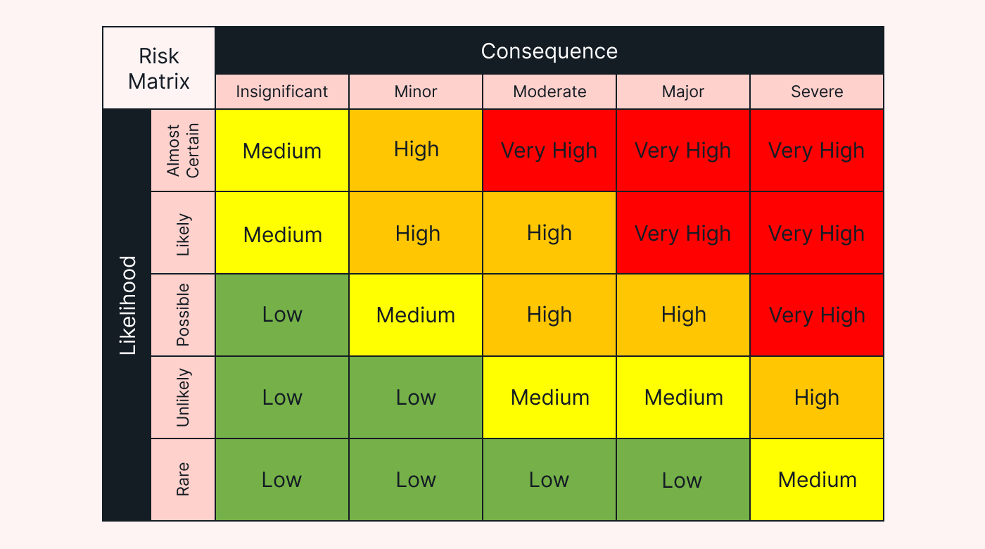
Risk Matrix A risk matrix is a tool that can help you rank the severity of organizational risks you have identified, to help you prioritize what actions to take. Instructions: First, identify and list your risks. Then, rank each one according to how likely it is to happen (the Y axis in the matrix), and what the consequence would be if it does happen (the X axis on the matrix). Put a ‘dot’ on the matrix for that risk. Once you have ranked all your risks, you will be able to see which are in the Low, Medium, High or Very High risk categories. This will help you plan your actions accordingly.
1
Risk | Describe | Likelihood | Consequence | Risk Level
1
2
3
4
5
Etc.
2
3
4
5

