Slide 1



Virginia’s Opioid Overdose and
Naloxone Education Program
Lay Rescuer Training
Updated February 2022

Slide 2
Learning Objectives
  Understand the REVIVE! program and legislation
  Understand addiction
  Understand how opioid overdose emergencies happen and how to recognize them
  Understand how naloxone works
  Identify risk factors that may make someone more susceptible to an opioid overdose emergency
  Dispel common myths about how to reverse an opioid overdose
  Learn how to respond to an opioid overdose emergency with the administration of naloxone

Slide 3
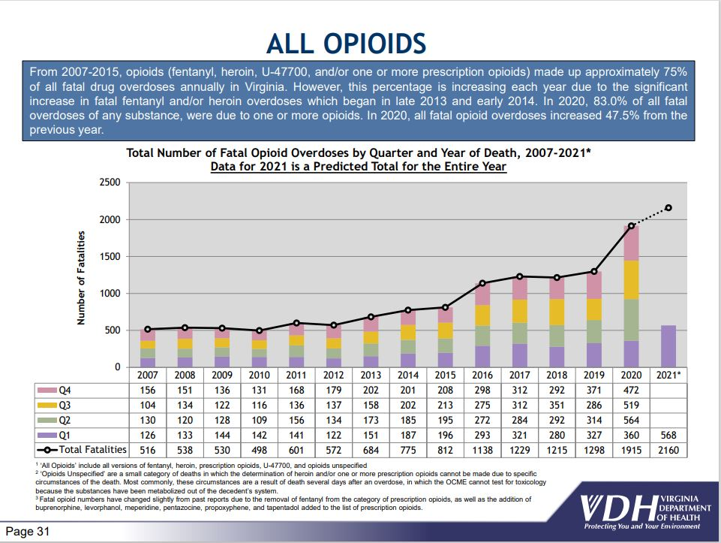

Slide 4
Legal Protections in Overdose Response
Virginia’s Good Samaritan Law (applies to any lay rescuers responding to overdose)
Any person who:
21. In good faith administers naloxone or other opioid antagonist used for overdose reversal to a person who is believed to be experiencing or about to experience a life-threatening opioid overdose in accordance with the provisions of subsection Z of § 54.1-3408 shall not be liable for any civil damages for any personal injury that results from any act or omission in the administration of naloxone or other opioid antagonist used for overdose reversal, unless such act or omission was the result of gross negligence or willful and wanton misconduct.
Subsection Z of § 54.1-3408:
Z. A person who is not otherwise authorized to administer naloxone or other opioid antagonist used for overdose reversal may administer naloxone or other opioid antagonist used for overdose reversal to a person who is believed to be experiencing or about to experience a life-threatening opioid overdose.

Slide 5
Safe Reporting of Overdoses
(applies to people involved in an overdose situation)
§ 18.2-251.03 Arrest and prosecution when experiencing or reporting overdoses
No individual shall be subject to arrest or prosecution for
the unlawful purchase, possession, or consumption of alcohol pursuant to § 4.1-305,
possession of a controlled substance pursuant to § 18.2-250,
possession of marijuana pursuant to § 18.2-250.1, intoxication in public pursuant to § 18.2-388,
or possession of controlled paraphernalia pursuant to § 54.1-3466 if:
1. Such individual (i) in good faith, seeks or obtains emergency medical attention (a) for himself, if he is experiencing an overdose, or (b) for another individual, if such other individual is experiencing an overdose, or (ii) is experiencing an overdose and another individual, in good faith, seeks or obtains emergency medical attention…
2. Such individual remains at the scene of the overdose or at any alternative location to which he or the person requiring emergency medical attention has been transported until a law-enforcement officer responds to the report of an overdose. If no law-enforcement officer is present at the scene of the overdose or at the alternative location, then such individual shall cooperate with law enforcement as otherwise set forth herein;
3. Such individual identifies himself to the law-enforcement officer who responds to the report of the overdose; and
4. The evidence for the prosecution of an offense enumerated in this subsection was obtained as a result of the individual seeking or obtaining emergency medical attention.
Note: C. The provisions of this section shall not apply …during the execution of a search warrant or during the conduct of a lawful search or a lawful arrest.

Slide 6
The Standing Order and Naloxone Access
A standing order has been issued for the State of Virginia allowing for individuals to go to any pharmacy to purchase naloxone without first obtaining a prescription from your doctor.
Naloxone can be obtained from:
Local health departments (no-cost)
Community services boards (no-cost)
Community pharmacies (insurance or out of pocket payment)
****Call your health department or community services board before going to ask about naloxone availability.****

Slide 7
Understanding Addiction
People don't plan to get addicted to drugs.
When people first take a drug, they might like how it makes them feel. They believe
they can control how much and how often they take the drug. But drugs can take
away people’s control. Drugs can change the brain.
Addiction refers to substance use disorders at the severe end of the spectrum and is characterized by a person’s inability to control the impulse to use drugs even when there are negative consequences.
https://easyread.drugabuse.gov/content/what-addiction

Slide 8

Nuggets Video
Video Courtesy of Filmbuilder and Friends. Online the video can be accessed at https://youtu.be/HUngLgGRJpo

Slide 9
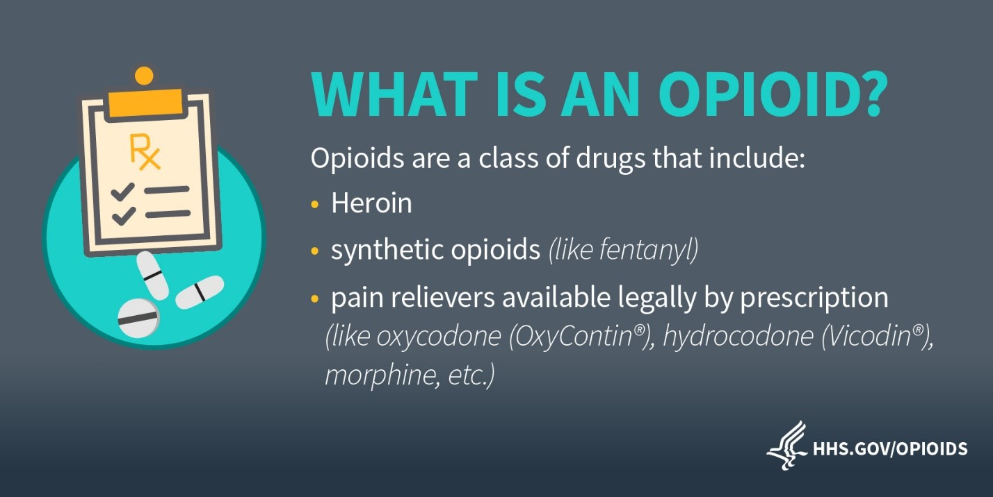

Slide 10
Common Opioids
Generic | Trade | Street
Hydrocodone | Lortab, Vicodin | Hydro, Norco, Vikes
Oxycodone | Oxycontin, Percocet | Ox, Oxys, Oxycotton, Kicker, Hillbilly Heroin
Morphine | Kadian, MSContin | M, Miss Emma, Monkey, White Stuff
Codeine | Tylenol #3 | Schoolboy, T-3s
Fentanyl | Duragesic | Apache, China Girl, China White, Goodfella, TNT
Carfentanil | Wildnil | Drop Dead, Flatline, Lethal Injection,
Hydromorphone | Dilaudid | Dill, Dust, Footballs, D, Big-D, M-2, M-80s, Crazy 8s, Super 8s
Oxymorphone | Opana | Blue Heaven, Octagons, Oranges, Pink, Pink Heaven, Stop Signs
Meperidine | Demerol | Dillies, D, Juice
Methadone | Dolophine, Methadose | Meth, Junk, Fizzies, Dolls, Jungle Juice
Heroin | Diacetylmorphine | Dope, Smack, Big H, Black Tar, Dog Food
Buprenorphine | Bunavail, Suboxone, Subutex, | Sobos, Bupe, Stops, Oranges
Tramadol | Ultram, ConZip | Chill Pills, Trammies, Ultras

Slide 11
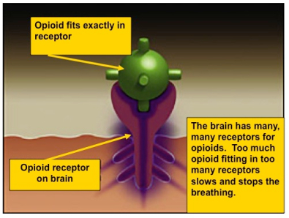
What Is an Opioid Overdose?
Opioid

Slide 12
What are risk factors
that can make someone more likely to experience an overdose?

Slide 13
Risk Factors for Opioid Overdose
Certain people are at higher risk for opioid overdose emergencies, including:
Prior Overdose
Reduced tolerance – previous users who have stopped using due to abstinence, illness, treatment, or incarceration
Mixing drugs – combining opioids with other drugs, including alcohol, stimulants or depressants. Combining stimulants and depressants DO NOT CANCEL EACH OTHER OUT
Using alone
Variations in strength or quantity or changing formulations (e.g., switching from quick acting to long lasting/extended release)
Medical conditions such as chronic lung disease or kidney or liver problems

Slide 14
How can you tell the difference
between someone who is high and
someone who has overdosed?

Slide 15
Signs of an Opioid Overdose
Really High | Overdosed
Muscles become relaxed | Face is very pale or clammy
Speech is slowed or slurred | Breathing is infrequent or has stopped
Sleepy-looking, “nod out” | Deep snoring or gurgling (death rattle)
Responsive to shouting, sternal rub or ear lobe pinch | Unresponsive to any stimuli
Normal heart rate and/or pulse, Normal skin tone | Slow or no heart rate and/or pulse
Pupils will contract and appear small “pinpoint pupils” | For lighter skinned people, the skin tone turns bluish purple, for darker skinned people, it turns grayish or ashen.
If someone is making unfamiliar sounds while “sleeping” it is worth trying to wake him
or her up. Many loved ones of users think a person was snoring, when in fact the person was overdosing. These situations are a missed opportunity to intervene and save a life.

Slide 16
What are some myths you have
heard about ways to reverse an
opioid overdose?

Slide 17
Myths on Overdose Response
There are many myths about how to reverse an opioid overdose. Here are some, and why you SHOULD NOT DO THEM.
DO NOT put the individual in a bath. They could drown.
DO NOT induce vomiting or give the individual something to drink. They could choke.
DO NOT put the person in an ice bath or put ice in their clothing or in any bodily orifices. Cooling down the core temperature of an individual who is experiencing an opioid overdose emergency is dangerous because it can further depress their heart rate.
DO NOT try and stimulate the individual in a way that could cause harm, such as slapping them hard, kicking them, or other more aggressive actions that may cause long-term physical damage.
DO NOT inject them with any foreign substances (e.g., salt water or milk) or other drugs or force them to eat or drink anything. It will not help reverse the overdose and may expose the individual to bacterial or viral infection, abscesses, endocarditis, cellulitis, choking, etc.

Slide 18
Naloxone is the only effective response to an opioid overdose emergency!

Slide 19
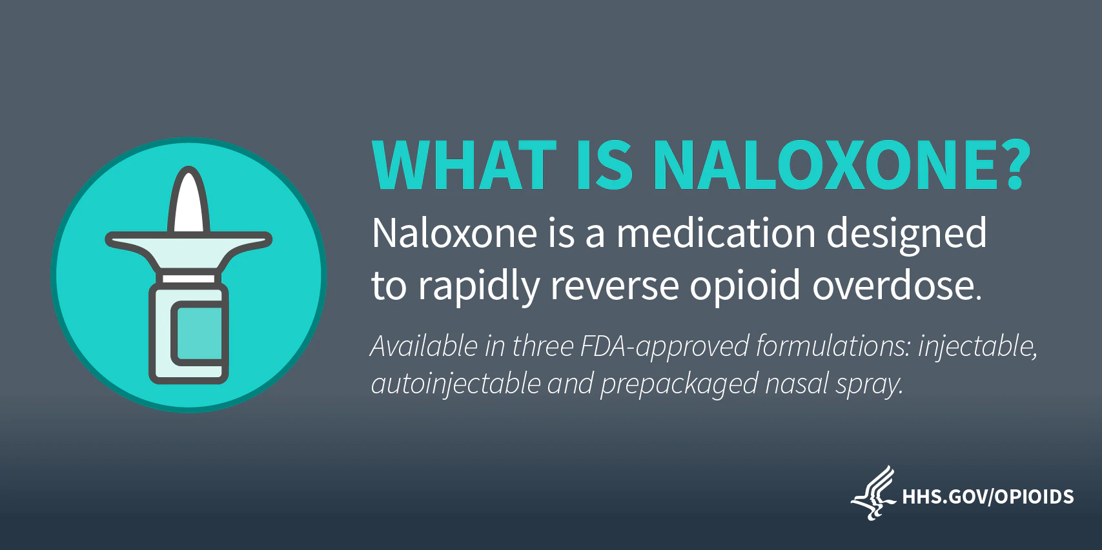

Slide 20
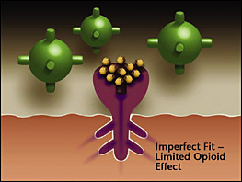
How Naloxone Works
Opioid
Naloxone has a stronger affinity to the opioid receptors than the opioid, so it knocks the opioid off the receptors for a short time (30-90 minutes) and lets the person breathe again.
Naloxone
Opioid receptor

Slide 21
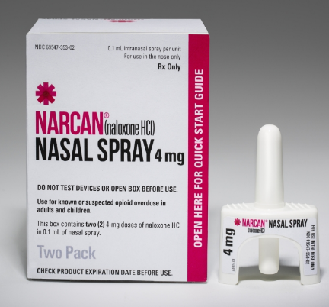
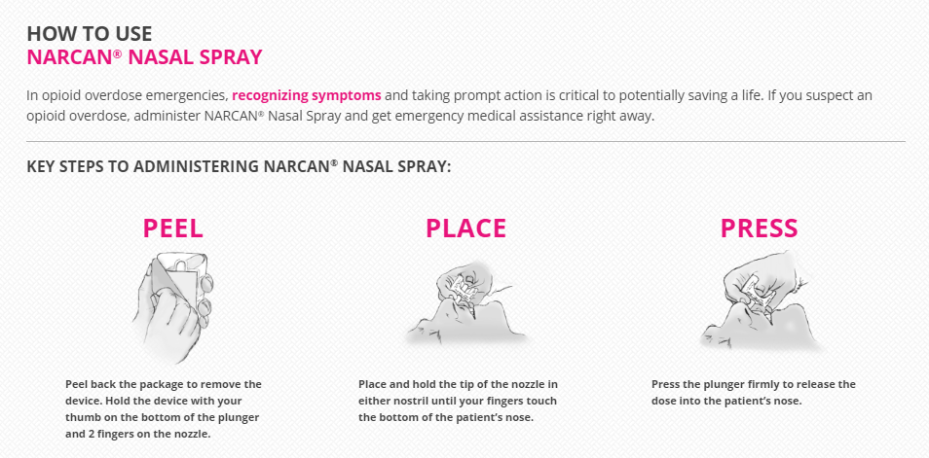
Narcan Nasal Spray
2 doses in each kit
https://youtu.be/xa7X00_QKWk

Slide 22
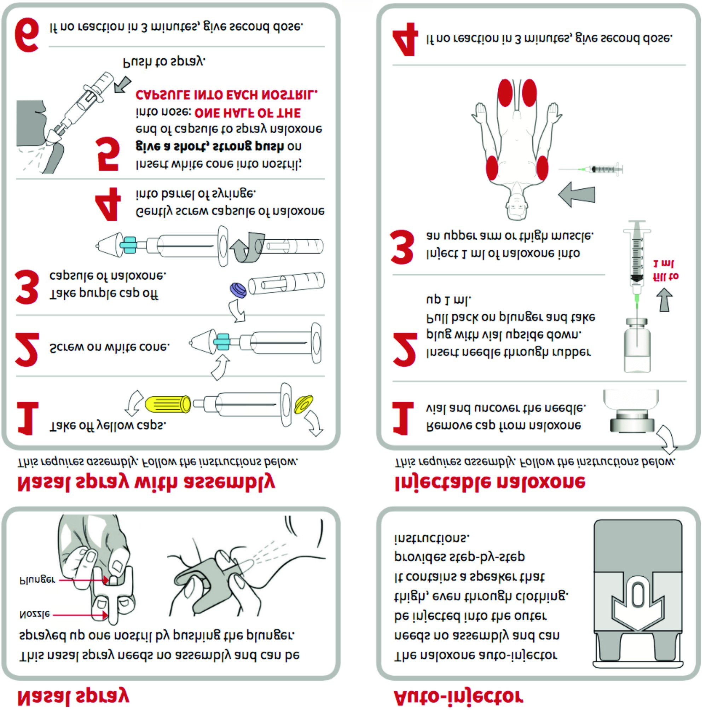
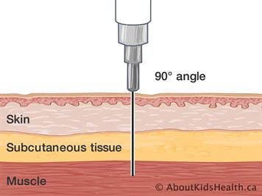
Injectable naloxone
Use a long needle: Virginia requires a (3mL) syringe with 23-25 gauge and 1-1.5 inch intramuscular (IM) needle
If available, clean the skin with an alcohol swab first.
It is ok, to inject through clothing if necessary.
90° angle to make sure you reach the muscle

Slide 23
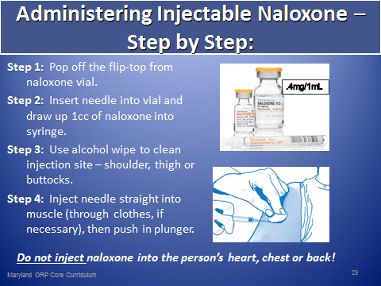
REVIVE! – IM Administration

Slide 24
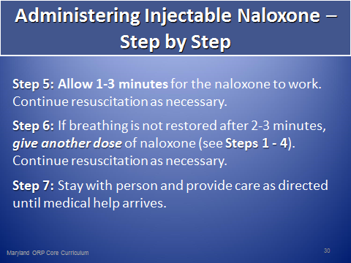
REVIVE! – Background

Slide 25
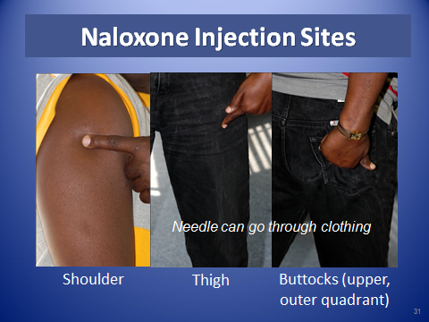
REVIVE! – Naloxone Injection Sites

Slide 26
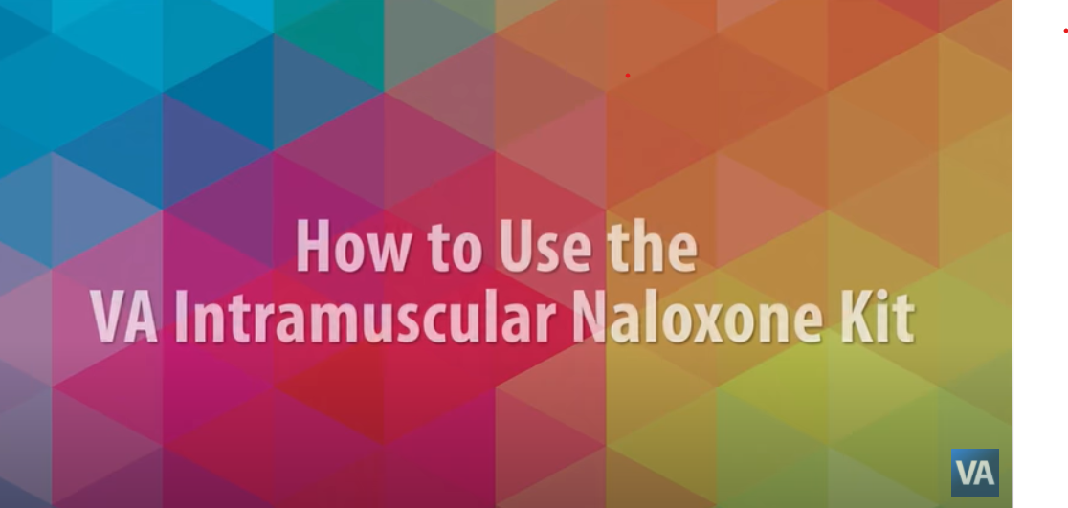
https://youtu.be/lg1LEw-PeTE

Slide 27
How to Store Naloxone
Naloxone has a shelf life of approximately 3 years (check the label on your product.) Store between 59°F to 77°F.
Naloxone may be stored for short periods up to 104°F.
Do not store naloxone in the car on hot summer days.
Do not freeze or leave naloxone in a car during the winter.
Naloxone may not be as effective if it is not stored properly. Only discard the naloxone once you have a replacement for it. If you don’t replace naloxone before it is needed, it is better to use it, even if it hasn’t been stored properly.
Naloxone does no harm when expired, so you may use an expired dose in an emergency if new doses are not available.
Store in a dark place and protect from light.
Keep out of reach and sight of children.

Slide 28
Safety of Naloxone
Serious side effects from naloxone use are very rare.
Using naloxone during an overdose far outweighs any risk of side effects. If the cause of the unconsciousness is uncertain, giving naloxone is not likely to cause further harm to the person. Reported side effects are often related to acute opioid withdrawal.
Naloxone will not reverse overdoses from other drugs, such as alcohol, benzodiazepines, cocaine, or amphetamines.
Naloxone has no abuse potential.
Naloxone has the same dose for an adult and a child.

Slide 29
Steps to Respond to an Opioid Overdose
Check for Responsiveness
Call 911, if you must leave the individual alone, place them into recovery position.
Give 2 Rescue Breaths (if the person is not breathing)
Administer Naloxone
Continue Rescue Breathing
Assess and respond based on outcome of first naloxone administration
**If you must leave an unresponsive person at anytime, put them in recovery position**

Slide 30
1. Check for Responsiveness
Try to stimulate them. You can shout their name, tap their shoulder, or pinch their ear lobe.
Give a sternum rub. Make a fist and rake your knuckles hard up and down the front of the person’s sternum (breast bone). This is sometimes enough to wake the person up.
Check for breathing. Put your ear to the person’s mouth and nose so that you can also watch their chest. Feel for breath and watch to see if the person’s chest rises and falls.
If the person does not respond or is not breathing, proceed to step 2

Slide 31
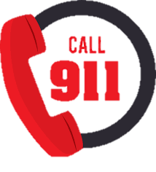
2. Call 911
Calling 911 immediately when responding to an overdose is vital. An individual who has overdosed needs to be assessed by medical professionals.
If there is more than one person around instruct another individual to call 911.
If with a cell phone call 911, put call on “speakerphone” and place phone on the ground.
Report that the person’s breathing has slowed or stopped, he or she is unresponsive, it is a suspected overdose, and give the exact location.

Slide 32
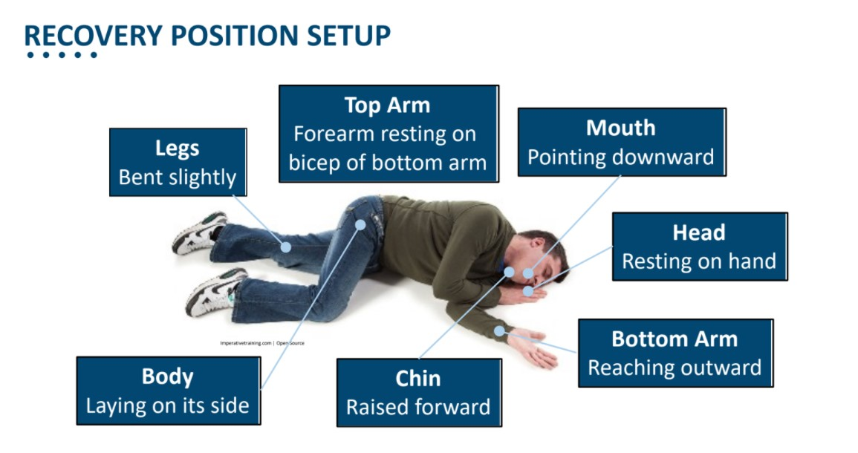

Slide 33
3. Give 2 Rescue Breaths
Place the person on their back.
Tilt their chin up to open the airway.
Plug/pinch their nose with one hand, and give 2 even, regular-sized breaths. Blow enough air into their lungs to make their chest rise. If you don’t see their chest rise out of the corner of your eye, tilt the head back more and make sure you’re plugging/pinching their nose.
https://youtu.be/31GdwcBdwRo

Slide 34
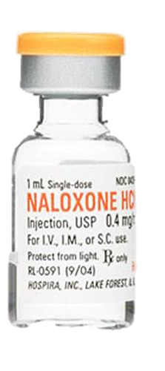
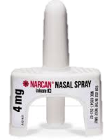
4. Administer Naloxone
Naloxone usually starts working within 30-45 seconds after it is given, but we give the person up to 3 minutes to respond. While you wait for naloxone to take effect, immediately begin Step 5.

Slide 35
5. Rescue Breathing or CPR (if rescuer is CPR trained or instructed to do so by 911)
Place the person on their back.
Tilt their chin up to open the airway.
Plug/pinch their nose with one hand, and give 2 even, regular-sized breaths. Blow enough air into their lungs to make their chest rise. If you don’t see their chest rise out of the corner of your eye, tilt the head back more and make sure you’re plugging/pinching their nose.
Repeat, give 1 breath every 5 seconds.
PLEASE NOTE - You may have heard that recent CPR guidelines recommend “hands-only CPR,” or only chest compressions instead of rescue breathing and chest compressions. These guidelines are for layperson response to cardiac arrest, and NOT overdose. It is still recommended that you perform rescue breathing for an overdose, where the primary issue is respiratory depression, and not cardiac arrest. Brain damage can occur after three to five minutes without oxygen. Rescue breathing gets oxygen to the brain quickly. Once you give naloxone, it may take some time for it to be take effect, so the person may not start breathing on their own right away. Continue rescue breathing/cpr for them until the naloxone takes effect or until emergency medical services arrive.

Slide 36
6. Assess and Respond
Most individuals will recover after a single dose of naloxone is administered. Ideally, while performing Step 5 the person will begin breathing on their own.
However, there are two cases in which you may need to administer a second dose of naloxone:
Situation A: If the individual has not responded to the initial dose within three minutes
Situation B: If the individual has relapsed into an overdose again after having previously recovered with the initial dose.

Slide 37
When to give a 2nd dose of naloxone
Situation A: The individual has not responded to the initial dose within three minutes
When this occurs:
Naloxone should take effect within 30-45 seconds but may take longer
Wait three minutes (continue rescue breathing/cpr during this time)
At three minutes, if still no response, administer second dose of naloxone
If person remains unresponsive after the second dose is administered, continue rescue breathing/CPR until emergency medical services arrives.
**If the individual has not responded to the initial dose or naloxone, administer the 2nd dose in the opposite nostril when using nasal spray**

Slide 38
When to give a 2nd dose of naloxone
Situation B: The individual has relapsed into an overdose again after having previously recovered with the initial dose.
Naloxone has a very short half life – 30-90 minutes. In some cases, there is so much opioid in the system that the person can relapse back into overdose after the naloxone has worn off.
If this occurs:
Repeat steps 1 through 5
Continue rescue breathing/CPR until person recovers or until emergency medical services arrives.
Opioid
Naloxone
Naloxone has a stronger affinity to the opioid receptors than the opioid, so it knocks the opioid off the receptors for a short time (30-90 minutes) and lets the person breathe again.
Opioid receptor

Slide 39
Aftercare of a Recovered Person
People wake up from an overdose differently.
While people are often confused and anxious, they are rarely violent or combative. This is a person in psychological distress.
Many times when people overdose they don’t realize what has happened.
Explain what happened and emphasize the importance of waiting for emergency medical services to arrive so they can be assessed.
If the person is dependent on opioids they will be in withdrawal since opioids cannot attach to receptors while naloxone is present – even if they take more drugs it will not help.
Let them know that once naloxone wears off they could potentially relapse into an overdose again if opioids are still in their system.

Slide 40
Hands-On Training
Take this time to practice mock scenarios responding to opioid overdoses.
Check for Responsiveness
Call 911, if you must leave the individual alone, place them into recovery position.
Give 2 Rescue Breaths (if the person is not breathing)
Administer Naloxone
Continue Rescue Breathing
Assess and respond based on outcome of first naloxone administration

Slide 41
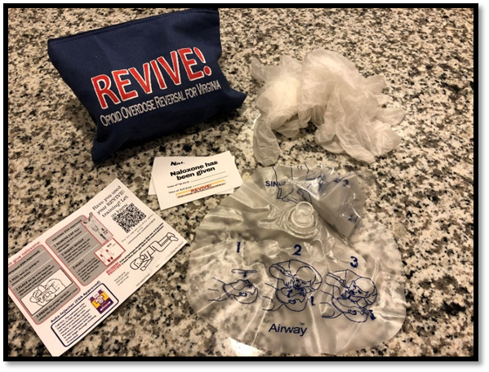
REVIVE! Kits
2 Pairs of Vinyl Gloves
2 Pocket Face Shield
1 Instruction Card
1 Canvas Carrying Case
If you use your REVIVE! training let us know using the link found on the instruction card in your kit!

Slide 42
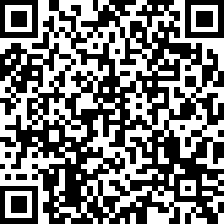
Thanks for your attendance!
For more information:
REVIVE@dbhds.virginia.gov
http://www.dbhds.virginia.gov/individuals-and-families/substance-abuse/revive
Complete the evaluation for today’s training!
https://ww.surveymonkey.com/r/SGL3NCX

Slide 43
Acknowledgements
REVIVE! would not be possible without the help of many public and private partners, who DBHDS would like to acknowledge for their invaluable assistance:
Boston Public Health Commission Bureau of Justice Assistance
Chicago Recovery Alliance
The Chris Atwood Foundation
Delegate John O’Bannon, R-73
Joanna Eller
Harm Reduction Coalition
The McShin Foundation
Massachusetts Department of Public Health
Multnomah County (OR) Health Department
New York City Department of Mental Health and Hygiene
New York State Division of Criminal Justice Services
Ed Ohlinger
One Care of Southwest Virginia
Project Lazarus
SAARA Recovery Center of Virginia
San Francisco Department of Health/DOPE Project
University of Washington Alcohol and Drug Abuse Institute
Virginia Department of Criminal Justice Services
Virginia Department of Health
Virginia Department of Health Professions
The Virginia Harm Reduction Coalition

