Slide 1

Virginia’s Opioid Overdose and Naloxone Education Program
Lay Rescuer Training

Slide 2

Learning Objectives
Overview of Substance Use Disorders and Addiction
Identify risk factors for overdose
Dispel common myths about overdose reversal methods
Understand how opioid overdose happens
Understand how Naloxone works in an overdose emergency
Review Legislation for legal protection during administration
Hands-on Training

Slide 3

Understanding Substance Use Disorders
Peoples first intake of a drug, could initially feel like a positive experience. As time goes on with continuous use, the things they used to enjoy aren’t as positive and the use of the drug is now taken to feel “normal.”
There is no specific timeline of dependency, as every person is different and can occur in the early stages of use.
Addiction is a treatable, chronic medical disease involving complex interactions among brain circuits, genetics, the environment, and an individual’s life experiences. People with addiction use substances or engage in behaviors that become compulsive and often continue despite harmful consequences. Prevention efforts and treatment approaches for addiction are generally as successful as those for other chronic diseases.
No single factor can determine whether a person will become dependent on a substance.
https://easyread.drugabuse.gov/content/what-addiction

Slide 4
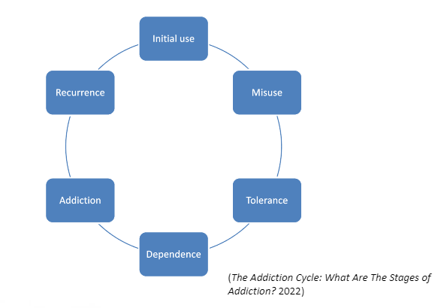
Cycle of Addiction

Slide 5

Nuggets
https://youtu.be/HUngLgGRJpo

Slide 6
OPIOIDS
Opioids (sometimes called narcotics) are a class of drugs that are chemicals — natural or synthetic — that interact with nerve cells that have the potential to reduce pain. Healthcare providers typically prescribe opioids to manage moderate to severe pain.

Slide 7
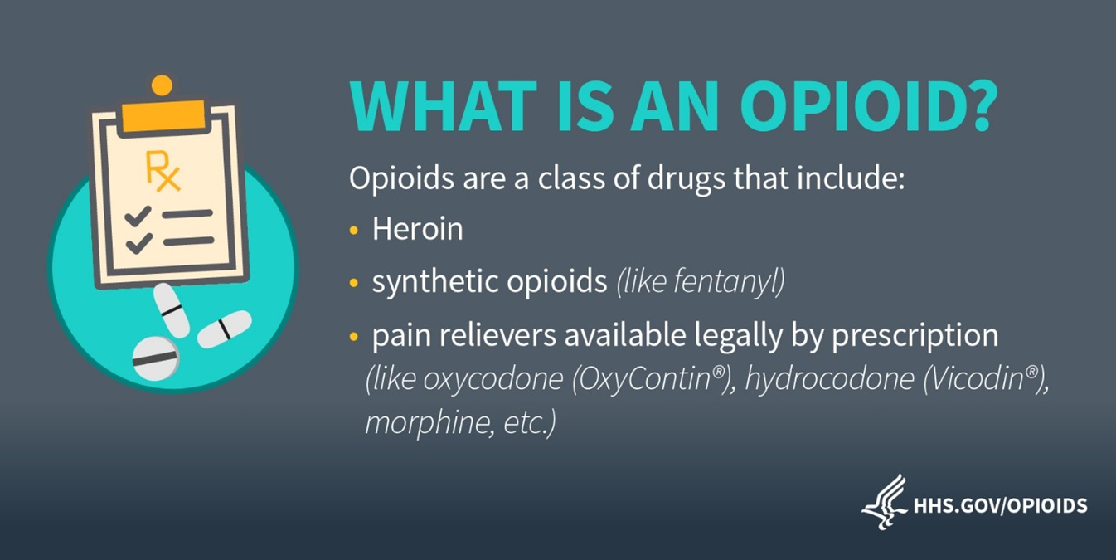

Slide 8
Common Opioids
GENERIC | Trade | Street
Hydrocodone | Lortab, Vicodin | Hydro, Norco, Vikes
Oxycodone | OxyContin, Percocet | Ox, Oxys, Oxycotton, Kicker
Morphine | Kadian, MSContin | M, Miss Emma, Monkey
Codeine | Tylenol #3 | Schoolboy, T-3’s
Fentanyl | Duragesic | Apache, China Girl, China White, Goodfella, TNT
Carfentanil | Wildnil | Dropdead, Flatline, Lethal Injection
Hydromorphone | Dilaudid | Dill, Dust, Footballs, Crazy 8’s,M-80s
Oxymorphone | Opana | Blue Heaven, Octagons, stop signs, Pink
Meperidine | Demerol | Dillies, D, Juice
Methadone | Dolophine, Methadose | Meth, Junk, Fizzies, Dolls, Jungle Juice
Heroin | Diacetylmorphine | Dope, Smack, Big H, Black Tar
Buprenorphine | Bunavail, Suboxone, Subutex | Sobos, Bupe, Stops
Tramadol | Ultram, ConZip | Chill Pills, Trammies, Ultras

Slide 9
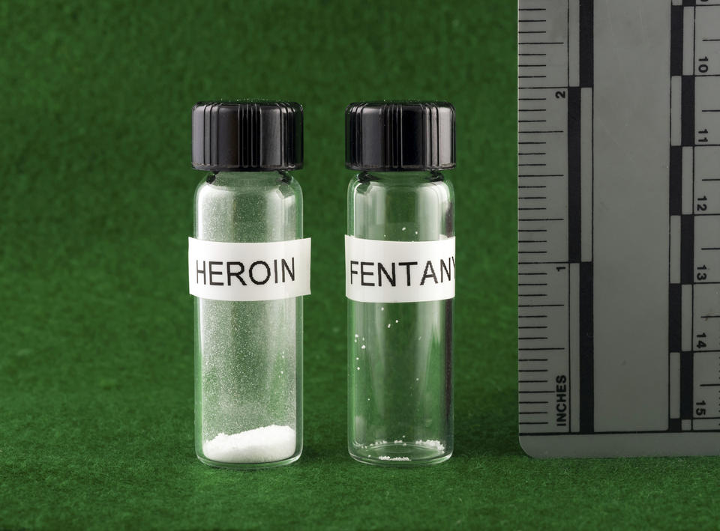
Risk of fentanyl contamination into other drugs like heroin, cocaine, pressed into pills etc., are a growing concern. It can lead into overdose even for those who may not be aware, and those who have not used opioids before.
A lethal dose of heroin compared to a lethal dose of fentanyl. This is just an illustration—the substance shown in this photo is an artificial sweetener.
Credit: Bruce A. Taylor/NH State Police Forensic Lab
https://www.cdc.gov/drugoverdose/deaths/opioid-overdose.html#synthetic

Slide 10
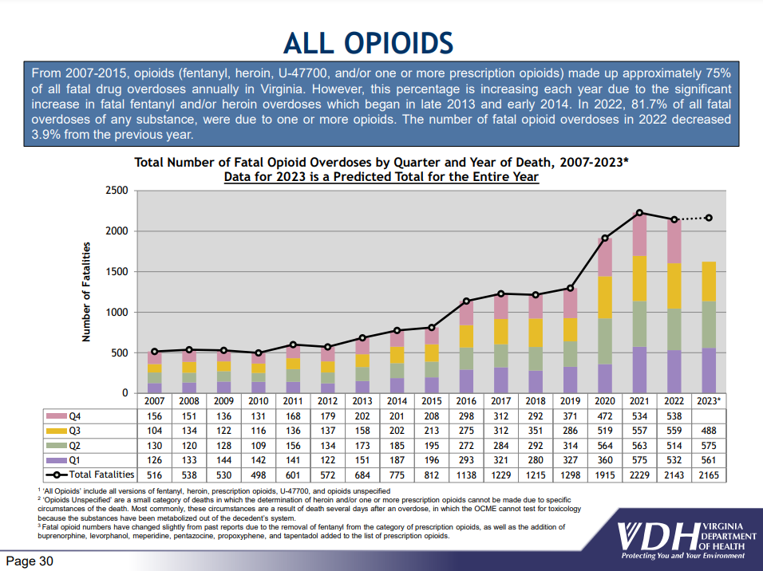
https://www.vdh.virginia.gov/content/uploads/sites/18/2023/07/Quarterly-Drug-Death-Report-FINAL-Q1-2023.pdf

Slide 11
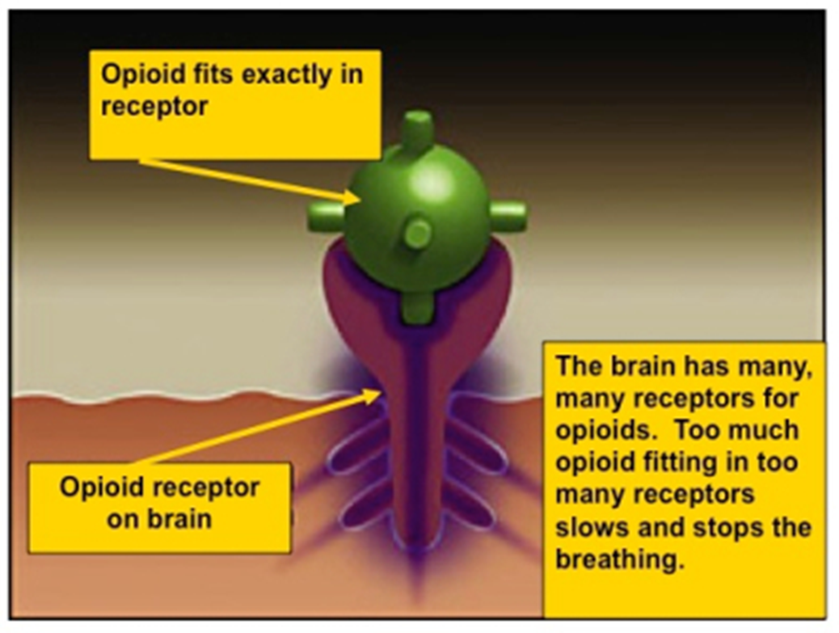
What is an Opioid Overdose?

Slide 12
What are risk factors that can make someone more likely to experience an overdose?

Slide 13
Certain people are at higher risk for opioid overdose emergencies, including:
Prior Overdose
Reduced tolerance – previous users who have stopped using due to abstinence, illness, treatment, or incarceration
Mixing drugs – combining opioids with other drugs, including alcohol, stimulants, or depressants. Combining stimulants and depressants DO NOT CANCEL EACH OTHER OUT
Using alone
Variations in strength or quantity or changing formulations (e.g., switching from quick acting to long lasting/extended release)
Medical conditions such as chronic lung disease or kidney or liver problems

Slide 14
How can you tell the difference between someone who is high and someone who has overdosed?

Slide 15
Really High | Overdosed
Muscles become relaxed | Face is very pale or clammy
Speech is slowed or slurred | Breathing is infrequent or has stopped
Sleepy-looking, “nod out” | Deep snoring or gurgling (death rattle)
Responsive to shouting, sternal rub or ear lobe pinch | Unresponsive to any stimuli
Normal heart rate and/or pulse, normal skin tone | Slow or no heart rate and/or pulse
Pupils will contract and appear small “pinpoint pupils” | For lighter skinned people, the skin tone turns bluish purple, for darker skinned people, it turns grayish or ashen
If someone is making unfamiliar sounds while “sleeping” it is worth trying to wake him or her up. Many loved ones of active users think a person was snoring, when in fact the person was overdosing. These situations are a missed opportunity to intervene to save a life.

Slide 16
What are some myths you have heard about ways to reverse an opioid overdose?

Slide 17
There are many myths about how to reverse an opioid overdose. Here are some, and why you should NOT do them.
DO NOT put the individual in a bath. They could drown.
DO NOT induce vomiting or give the individual something to drink. They could choke.
DO NOT put the person in an ice bath or ice in their clothing or in any bodily orifices. Cooling down the core temperature of someone who is experiencing an opioid overdose emergency is dangerous because it can further depress their heart rate.
DO NOT try and stimulate the individual in a way that could cause harm, such as slapping them hard, kicking them, or other more aggressive actions that may cause long-term physical damage.
DO NOT inject them with any foreign substances (e.g., salt water or milk) or other drugs or force them to eat or drink anything. It will not help reverse the overdose and may expose the individual to bacterial or viral infection, abscesses, endocarditis, cellulitis, choking, etc.

Slide 18
Naloxone is the only effective response to an opioid overdose emergency!

Slide 19
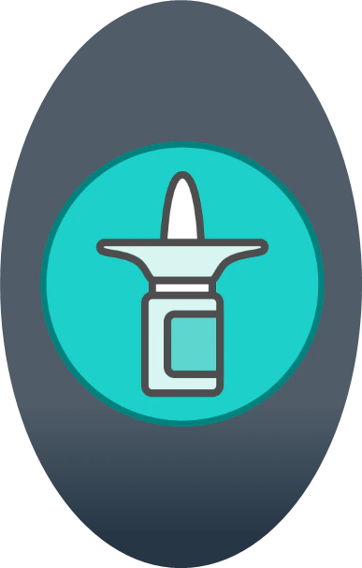
What is Naloxone?
Naloxone is a medication designed to rapidly reverse opioid overdose.
Available in two FDA-approved formulations:
Injectable and prepackaged nasal spray.

Slide 20
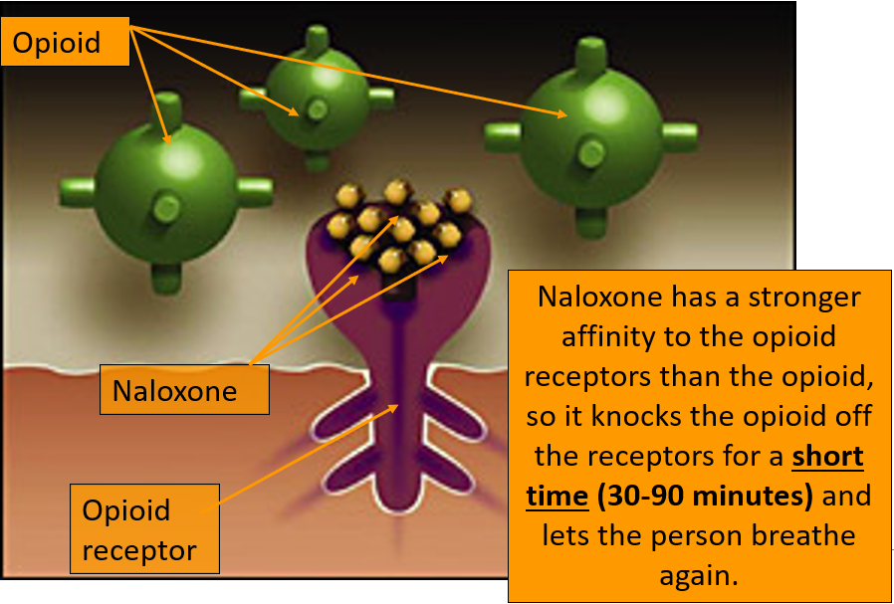
How Naloxone Works

Slide 21
Safety of Naloxone
Serious side effects from Naloxone use are rare.
Using Naloxone during an opioid overdose far outweighs any risk of side effects. Reported side effects are often related to acute opioid withdrawal.
Naloxone has the same dose for an adult and a child.
Naloxone has no abuse potential.
Naloxone will NOT reverse overdoses from other drugs such as:
Alcohol, benzodiazepines, cocaine, amphetamines or xylazine.

Slide 22
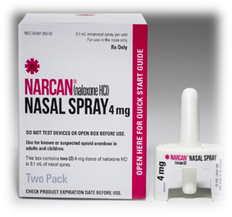
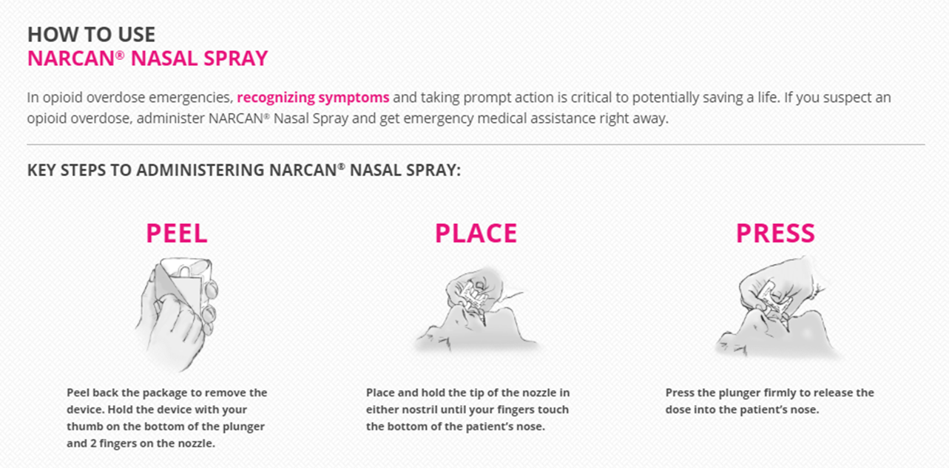
Narcan Nasal Spray
Please note:
Narcan is the brand name. Naloxone is the medication.
*2 doses in each kit

Slide 23
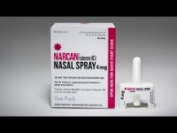
https://www.youtube.com/watch?v=xa7X00_QKWk

Slide 24
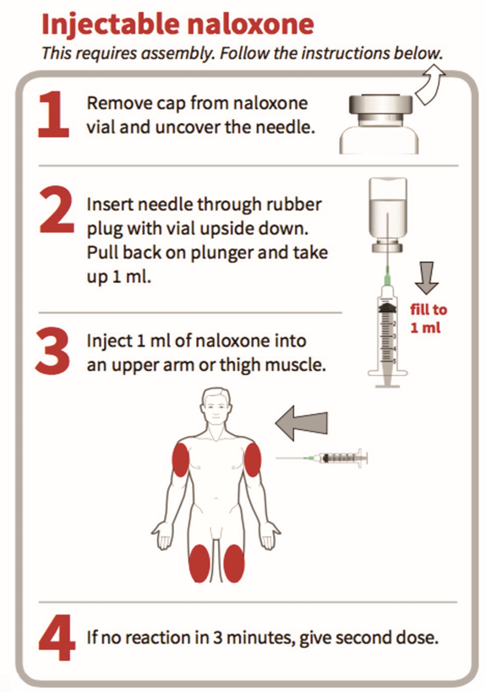
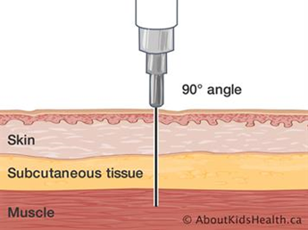

Injectable Naloxone
Tips:
If available, use alcohol wipe to clean injection site
DO NOT inject into the person’s heart, chest or back!
Can inject through clothing if necessary
90° angle to make sure you reach the muscle

Slide 25
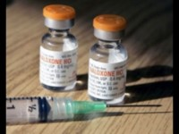
https://www.youtube.com/watch?v=_ojGrGchyGc

Slide 26
How to Store Naloxone
Naloxone has a shelf life of approximately 3 years (Check the label on your product)
Store between 59°F to 77°F.
May be stored for short periods up to 104°
Store in a dark place and protect from light.
As advised with all medications, keep out of reach of small children
Naloxone may not be as effective if it is not stored properly
Only discard the naloxone once you have a replacement for it. If you do not replace naloxone before it is needed, it is better to use it, even if it hasn’t been stored properly.
Naloxone may be less effective when expired; however, you may use an expired dose in an emergency if new doses are not available.

Slide 27
Steps to Respond to an Opioid Overdose
Check for Responsiveness
Call 911, if you must leave the individual alone, place them into recovery position.
Give 2 Rescue Breaths (if the person is not breathing)
Administer Naloxone
Continue Rescue Breathing
Assess and respond based on outcome of first naloxone administration
**If you must leave an unresponsive person at anytime, put them in recovery position**

Slide 28



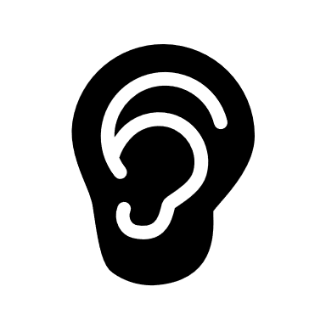
Check for Responsiveness
Try to stimulate them.
Shout their name, tap their shoulder, or pinch their ear lobe.
Give a sternum rub.
Make a fist and rake your knuckles hard up and down the front of the persons sternum (breastbone). This is sometimes enough to wake the person up.
Check for breathing.
Put your ear to the person’s mouth and nose so that you can also watch their chest. Feel for breath and watch to see if the person’s chest rises and falls.
If the person does not respond or is not breathing, proceed to step 2.

Slide 29


Call 911
Calling 911 immediately when responding to an overdose is vital. An individual who has overdosed needs to be assessed by medical professionals.
If there is more than one person around, instruct another individual to call 911. Avoid the bystander effect.
If you have a phone, call 911, put call on “speakerphone” and place phone on the ground.
Give the exact location.
Report that the person’s breathing has slowed or stopped, that he/she/they are unresponsive, and it is a suspected overdose.

Slide 30
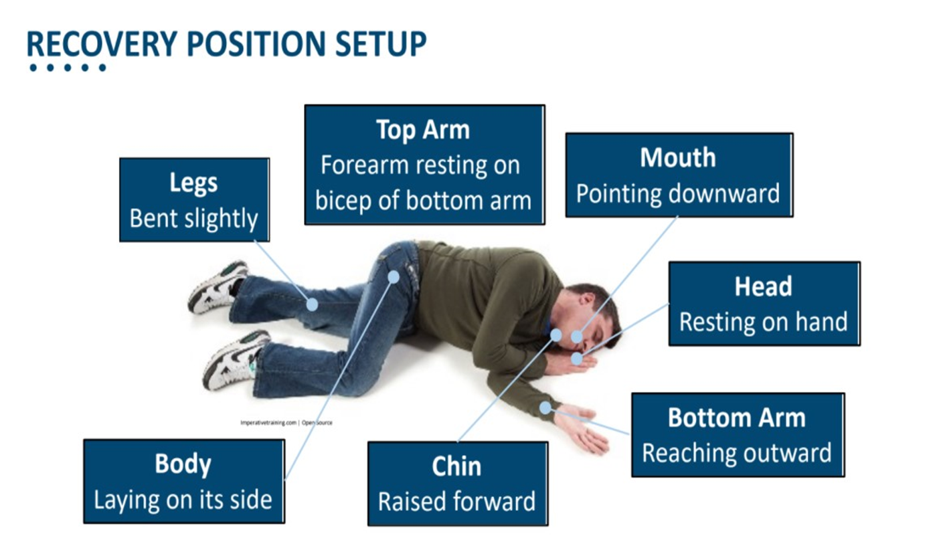
**If you must leave an unresponsive person at anytime, put them in recovery position**

Slide 31

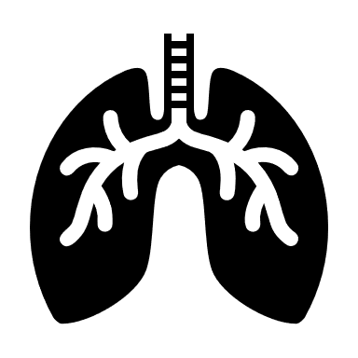

Give 2 Rescue Breaths
Place the person on their back.
Tilt their chin up to open the airway.
Plug/pinch their nose with one hand, and give two even, regular-sized breaths. Blow enough air into their lungs to make their chest rise. If you do not see their chest rise out of the corner of your eye, tilt the head back more and make sure you’re plugging/pinching their nose.

Slide 32
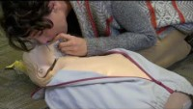
https://youtu.be/31GdwcBdwRo

Slide 33
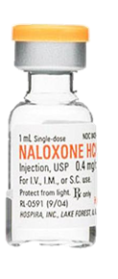
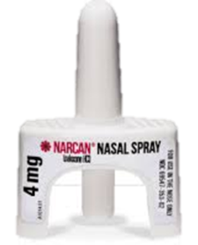
Administer Naloxone
Naloxone takes effect within 30-45 seconds after its given, but we give the person up to 3 minutes to respond.
While waiting for naloxone to take effect and for response, immediately begin step 5.

Slide 34
Rescue Breathing or CPR (if rescuer is CPR trained or instructed to do so by 911)
Place the person on their back.
Tilt their chin up to open the airway.
Plug/Pinch their nose with one hand, and give 2 even, regular-sized breaths. Blow enough air into their lungs to make their chest rise. If you don’t see their chest rise out of the corner of your eye, tilt the head back more and make sure you’re plugging/pinching their nose.
Give 1 breath every 5 seconds. Repeat this step until the person begins breathing on their own.
PLEASE NOTE – You may have heard that recent CPR guidelines recommend “hands-only CPR,” or only chest compressions instead of rescue breathing and chest compressions. The CPR guidelines are for layperson response to cardiac arrest, and NOT overdose. It is still recommended that you perform rescue breathing for an overdose, where the primary issue is respiratory depression, and not cardiac arrest. Brain damage can occur after three-to-five-minute without oxygen. Rescue breathing gets oxygen to the brain quickly. Once you give naloxone, it may take some time to take effect, so the person may not start breathing on their own right away. Continue rescue breathing/CPR for them until the naloxone takes effect or until emergency medical services arrive.

Slide 35
Assess and Respond
Most individuals will recover after a single dose of naloxone is administered. Ideally, while performing step 5 the person will begin breathing on their own.
However, there are two cases in which you may need to administer
a second dose of naloxone.

Slide 36
When to give a 2nd dose of Naloxone
Situation A: The individual has NOT responded to the initial dose within three minutes
After waiting the three minutes, if still no response, administer the second dose of Naloxone*
If person remains unresponsive after the second dose is administered continue rescue breathing/CPR until emergency response services arrives.
**Can administer 2nd dose in opposite nostril if using nasal spray or if administering the injectable naloxone, please use another designated injection site.**

Slide 37
When to give a 2nd dose of Naloxone
Situation B: The individual suffers a relapse into an overdose again after having previously recovered with the initial Naloxone dose.
Naloxone has a short half life – 30-90minutes. In some cases, there is an excessive amount of opioids in the system that the person can relapse back into overdose after the naloxone has worn off.
If this occurs:
Repeat steps 1-5.
Continue rescue breathing/CPR until person recovers or until emergency medical services arrive.

Slide 38
Aftercare of a Recovered Person
People wake up from an overdose differently.
While people are often confused and anxious, they are rarely violent or combative. This is a person in psychological distress. Give them space.
Explain to them what happened and emphasize the importance of waiting for emergency medical services to arrive so they can be assessed.
Let them know that once naloxone wears off, they could potentially relapse into an overdose again if opioids are still in their system.
If the person is dependent on opioids, they will experience acute withdrawal symptoms like:
Disorientation, nausea and vomiting, sweating, shaking etc.

Slide 39
NALOXONE FAQ
Where can I get Naloxone?
Local Pharmacy or retailer:
Over the Counter Narcan nasal spray naloxone is available for purchase at local pharmacies, retailers, in store and online.
Community Service Boards and Local Health Departments. Call ahead to inquire for availability and eligibility.
Healthcare Providers may issue a prescription for naloxone
Is naloxone free?
You may check with your local health district or community service board, to determine if you are eligible for no-cost naloxone. Availability may vary.
Do I need a prescription?
Prescription is no longer required however, the State Health Commissioner’s standing order is still in place, serving as a prescription for the public. At the discretion of the pharmacy, a claim to the insurance carrier may be submitted to cover some, or all, of the cost of naloxone.

Slide 40
Legal Protections in Overdose Response
Immunity from Civil Liability
Pertains to any Lay Rescuer
Code of Virginia Subsection Z of § 54.1-3408
Grants “a person who in good faith… administers naloxone…for overdose reversal in an emergency to an individual who is believed to be experiencing or about to experience a life-threatening opioid overdose shall not be liable for any civil damage for ordinary negligence in acts or omissions resulting from the rendering of such treatment.”

Slide 41
Legal Protections in Overdose Response
No individual shall be subject to arrest or prosecution for:
Simple possession of a controlled substance, marijuana, or controlled paraphernalia
Intoxication in public
The unlawful purchase, possession, or consumption of alcohol if the evidence for the charge was found as a result obtaining emergency medical attention.
To qualify you must (a)seek emergency medical attention, for yourself or someone else (b) remain at the scene or with the person until law enforcement arrives and (c) identify yourself to the responding law-enforcement officer.
Note: This law does not apply if the emergency medical attention sought or obtained was during the execution of a search warrant or during the conduct of a lawful search or a lawful arrest.
Safe Reporting of Overdoses Law
Pertains to BOTH the person overdosing
and the person seeking help
Code of Virginia § 18.2-251.03

Slide 42
Hands-On Training
Take this time to practice mock scenarios responding to opioid overdoses.
Check for Responsiveness
Call 911, if you must leave the individual alone, place them into recovery position.
Give 2 Rescue Breaths (if the person is not breathing)
Administer Naloxone
Continue Rescue Breathing
Lastly Assess and Respond based on outcome of first naloxone administration

Slide 43
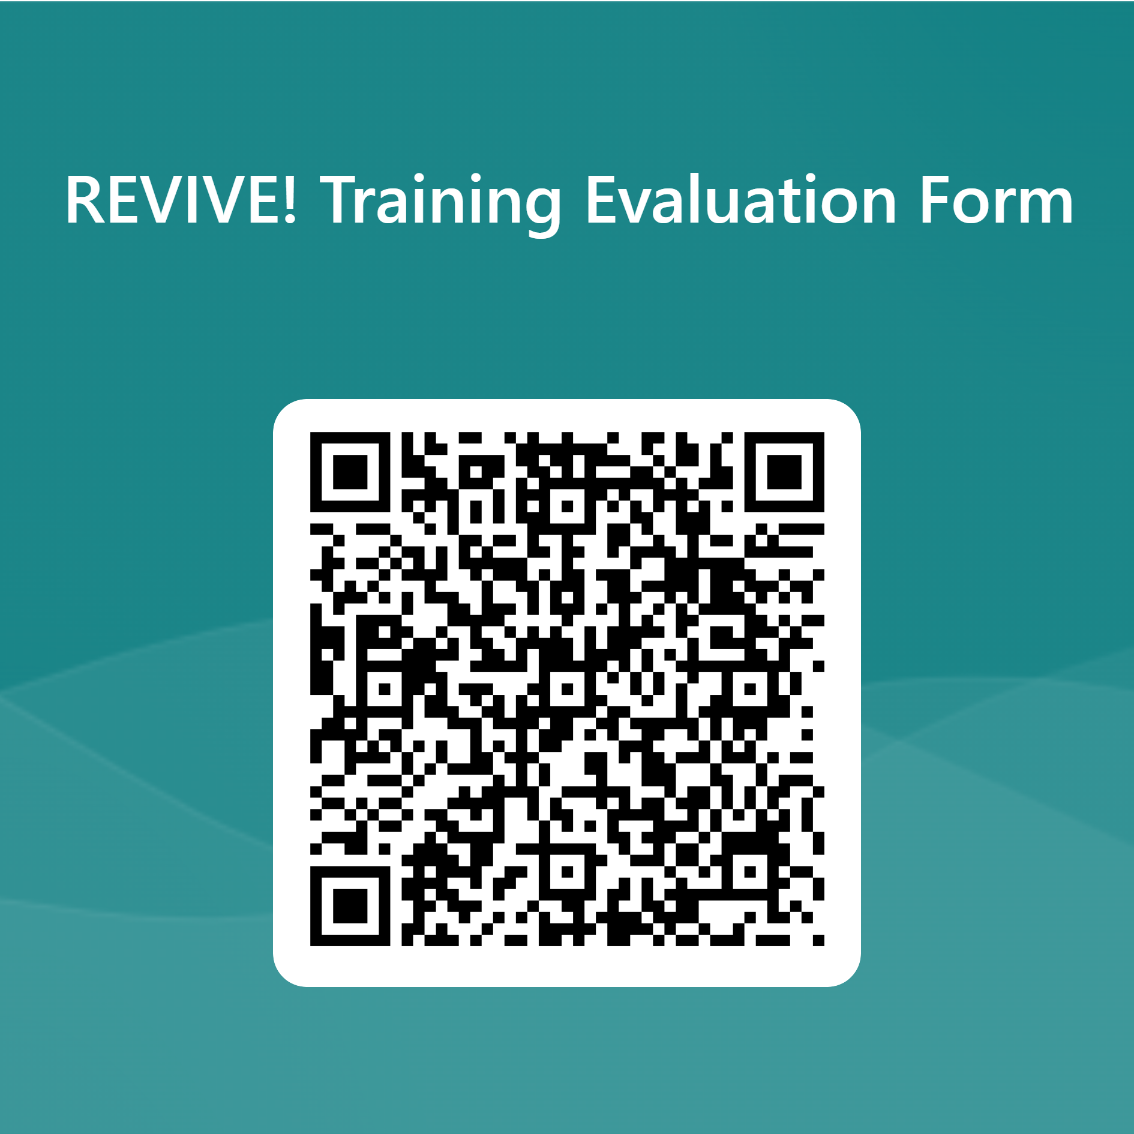
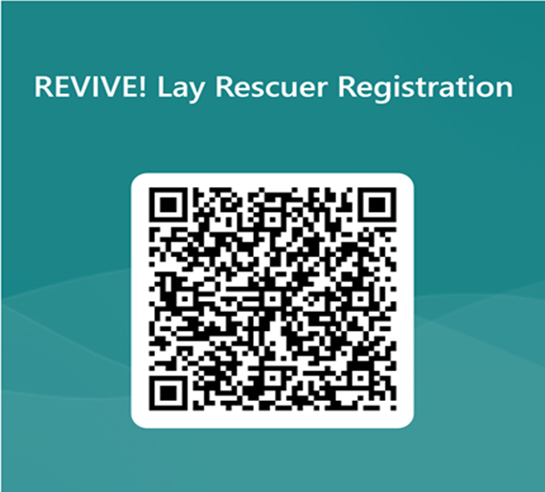
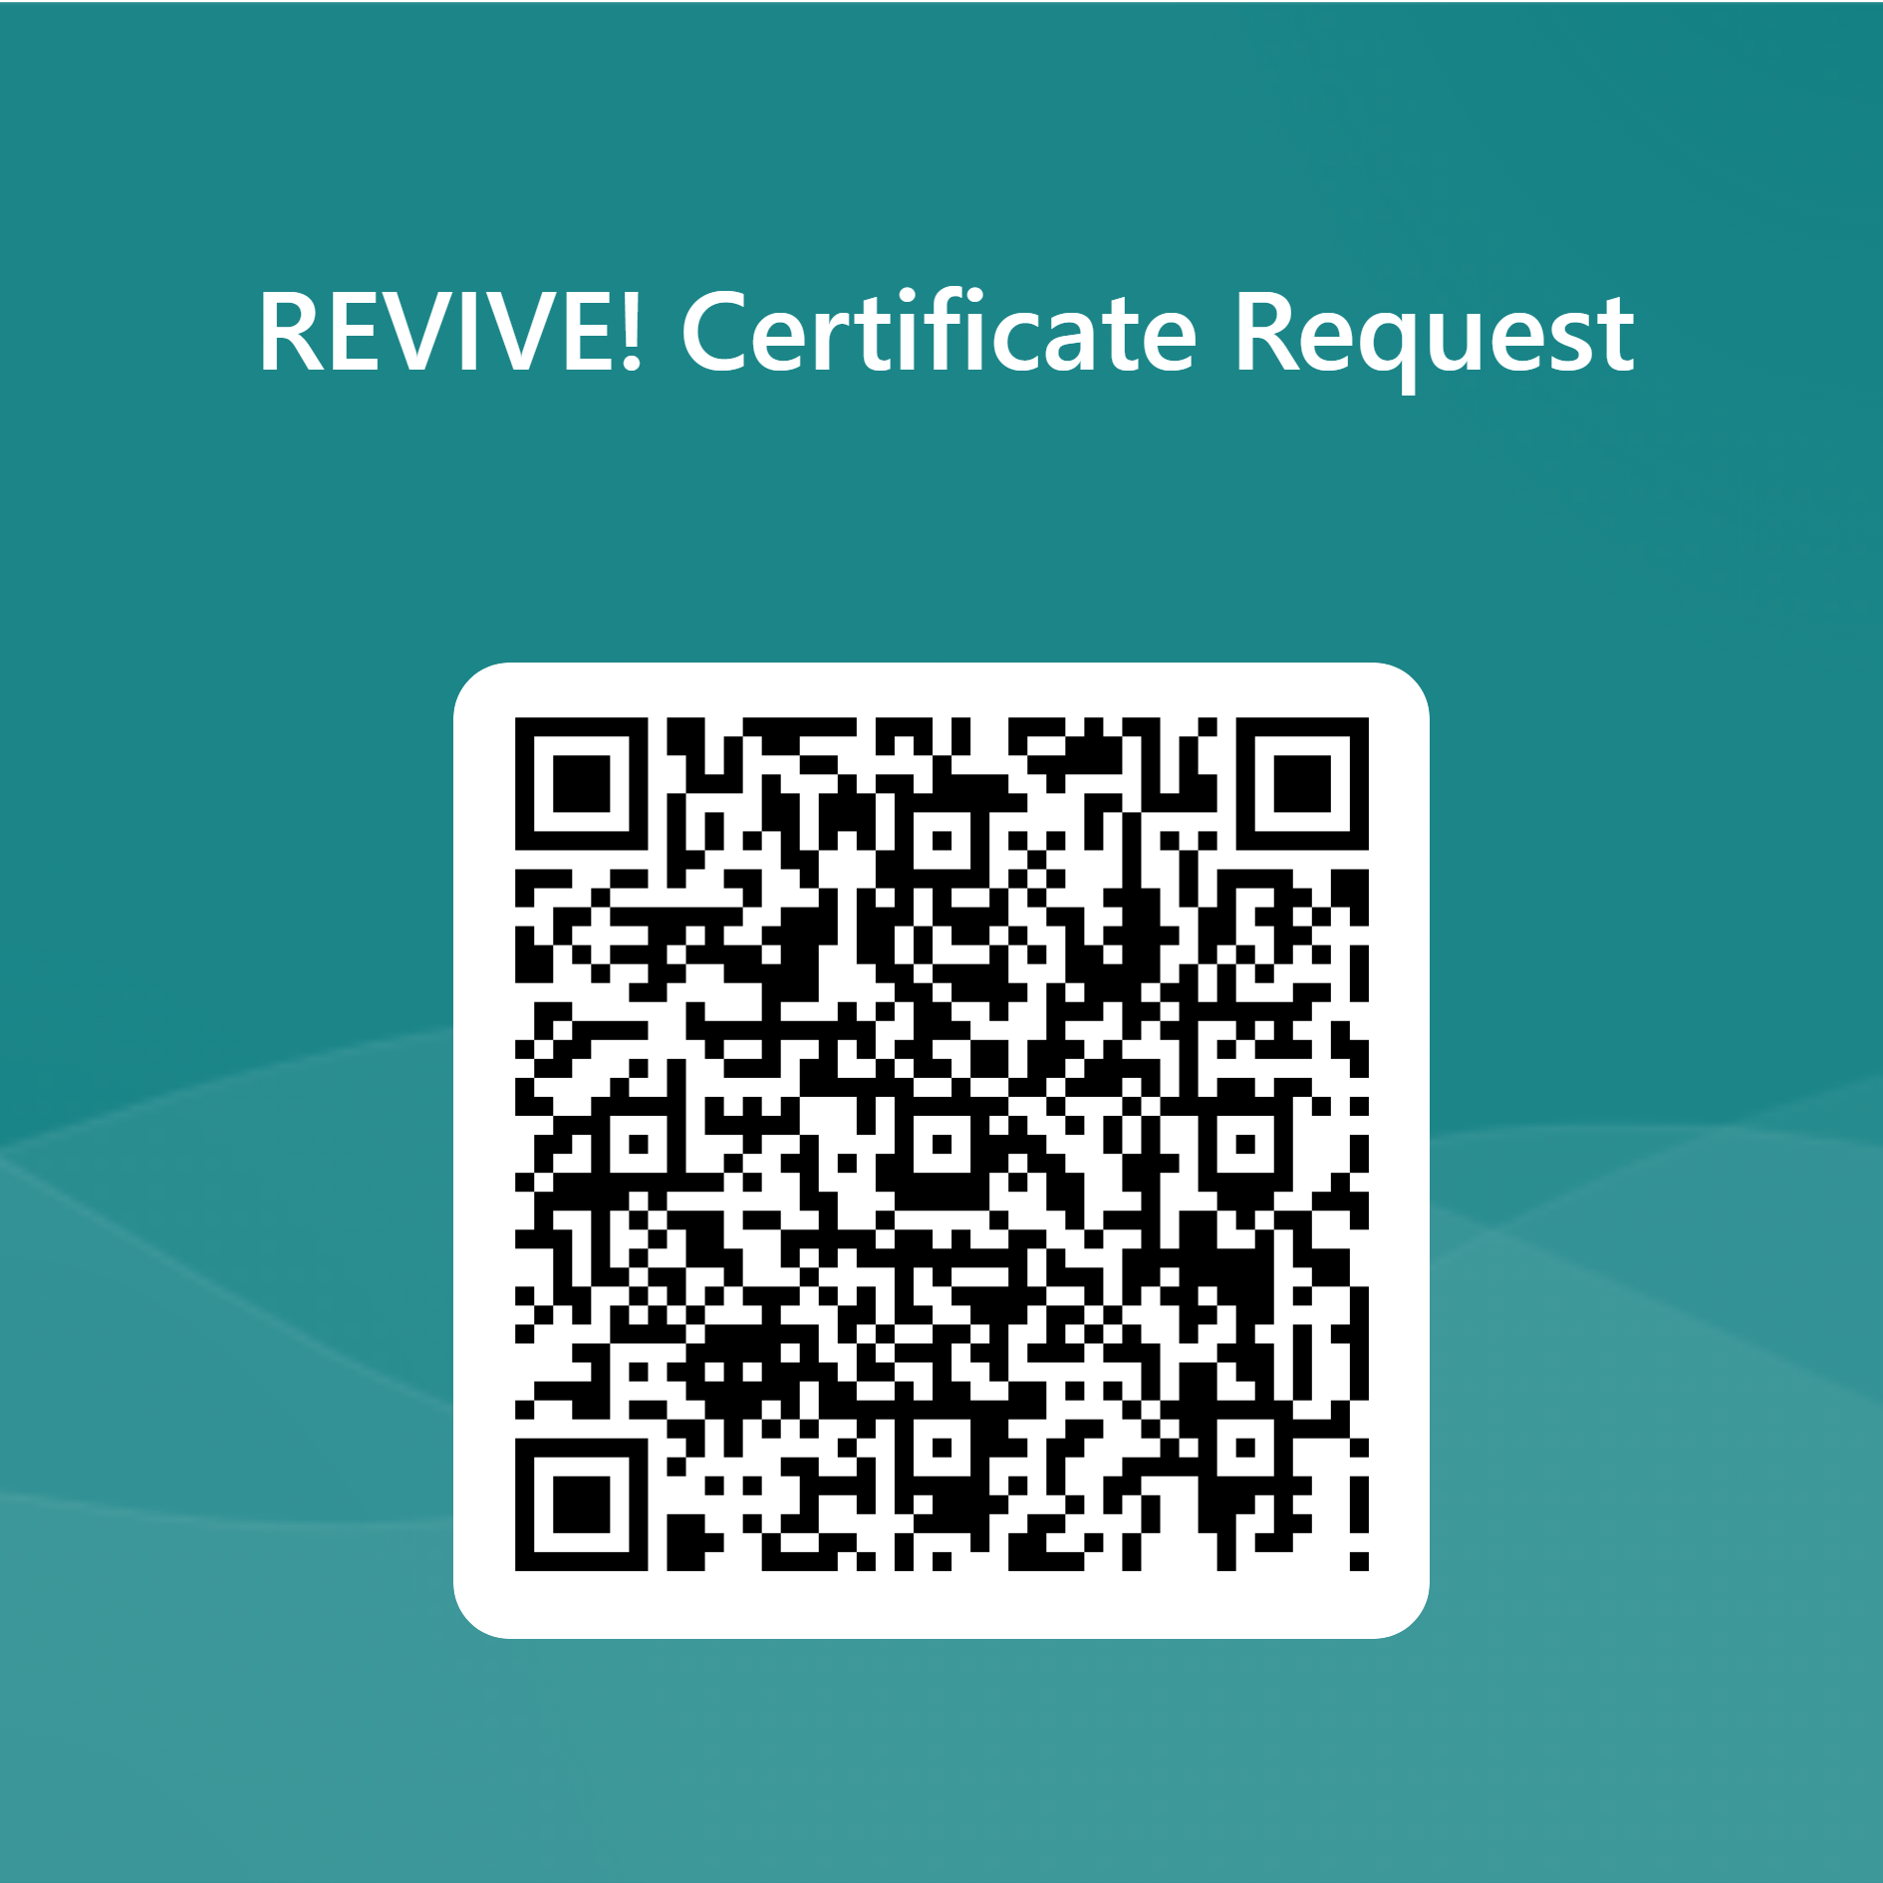
Thank you for your attendance!
For additional information email:
REVIVE@dbhds.virginia.gov

